Slide 1
SOLAR TRACKER FOR EFFICIENT UTILISATION OF SOLAR RADIATION
GROUP : 7
AMALRAJ K -10
A NAMITH KRISHNAN-11
VISHNU PREMANANDAN-58
MOHAMMED YASEEN-35

Slide 2
INTRODUCTION
Renewable energy solutions are becoming popular.
Solar energy is very large,inexaustable source of energy.
Maximizing output from solar system increases efficiency.
Presently solar panel are of fixed type which lower the efficiency.
Maintaining vertical direction between light and panel maximizes efficiency.
Solar tracking system has 35% higher power generation than fixed.
Solar tracking system based on PLC can adjust automatically orientation of panel.

Slide 3
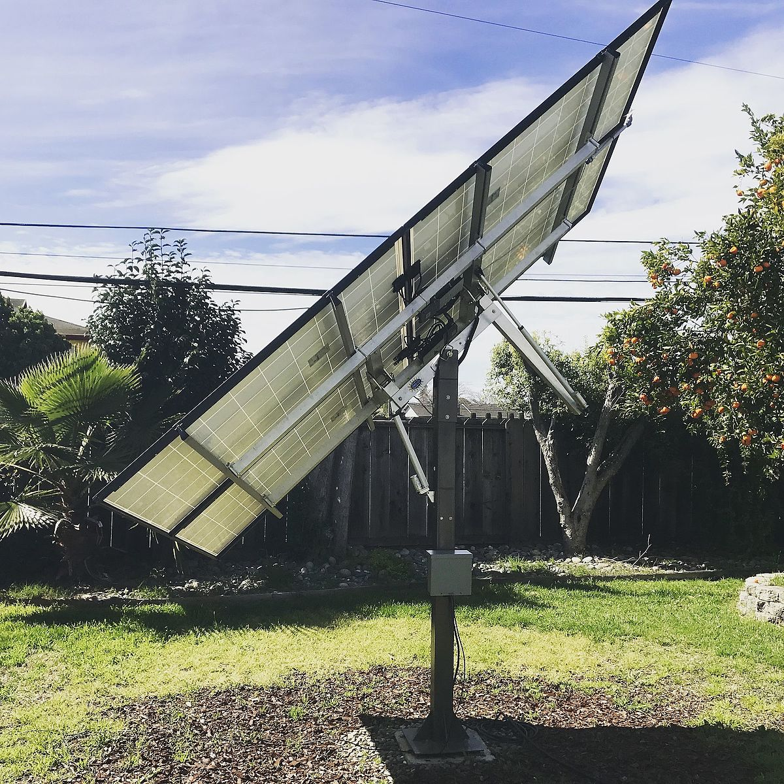

WHAT IS SOLAR TRACKER?
A solar tracker is a device used for orienting a solar photovoltaic panel or lens towards the sun by using the solar or light sensors connected with the machine.

Slide 4
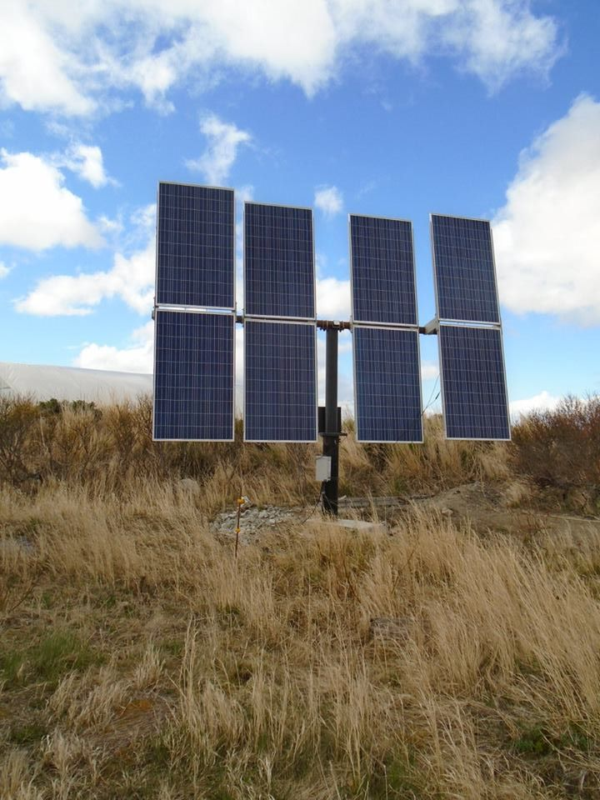
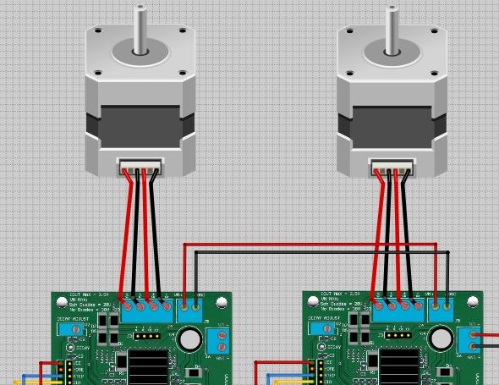
NEED OF SOLAR TRACKER
Increase solar panel output.
Maximum efficiency of the panel
Maximize power per unit area.
Able to grab the energy through out the day.

Slide 5
TYPES OF SOLAR TRACKERS
SINGLE AXIS TRACKERS
DUAL AXIS TRACKERS
Single axis solar trackers can either have a horizontal or a vertical axle.
Double axis solar trackers have both a horizontal and vertical axis.
It can track the sun’s apparent motion exactly anywhere in the world.

Slide 6
WORKING PRINCIPLE
Auto tracking control systems composed of PLC,sensors,signal processing units,Pvcells,electromagnetic and magnetic motion control modules and power supply system.
Panel detects the sun light strength to sensors.
The sensor output is given to the PLC which compares it and produces an equivalent output so as to rotate the motor and align the panel in the direction of sun.

Slide 7
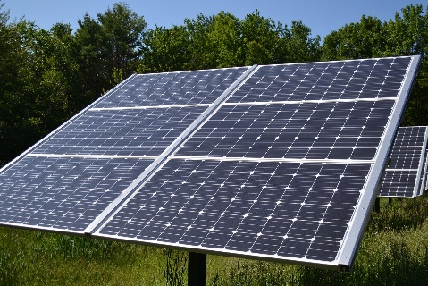
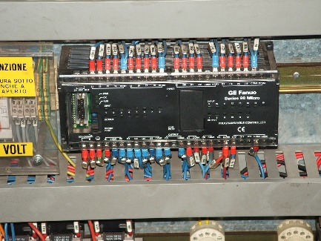
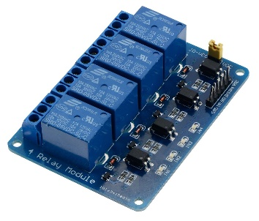
HARDWARE COMPONENT
SOLAR PANEL - it is number of solar cells connected in series internally.
LDR SENSORS - high resistance semiconductor whose resistance decreases with increasing incident light intensity.
STEPPER MOTOR - its an electromechanical devices which converts digital pulse inputs to incremental shaft rotation.
RELAY – its an electrically operated switch used for switching of large currents.
PLC- programmable logic controller.

Slide 8
ADVANTAGES….
Simple
Eco friendly
We can monitor directly using PC.
Tracking accuracy is more.
Reduces the usage of power from power grid.
Generate more electricity in roughly the same amount of space needed for fixed tilt systems.
Generate more electricity than their stationary counterparts due to increased direct exposure to solar rays.

Slide 9
CONCLUSION
The invention of solar tracking systems help us improve the performance of PV solar system in a simple way.
Used relative method of sunlight strength.
Established a model of automatic tracking system to keep vertical contact between solar panels and sunlight.
Improved the utilization rate of solar energy and efficiency of photovoltaic power generation systems.

Slide 10
WE HAVE THIS HANDY FUSION REACTOR IN THE SKY CALLED THE SUN.YOU DON’T HAVE TO DO ANYTHING.IT JUST WORKS.IT SHOWS UP EVERYDAY AND PRODUCES RIDICULOUS AMOUNTS OF POWER.- Elon Musk[CEO Tesla and co-founder]
REFERENCES
Google
Wikipedia
https://www.sciencedirect.com
https://www.solarpowerworldonline.com

